Slide 1
6
Ethics and Privacy
Dr. Asawari Dudwadkar
Asst. Prof. ETRX Dept.

Slide 2
Ethical Issues
Privacy

Slide 3
Define ethics, list and describe the three fundamental tenets of ethics, and describe the four categories of ethical issues related to information technology.
Identify three places that store personal data, and for each one, discuss at least one potential threat to the privacy of the data stored there.

Slide 4
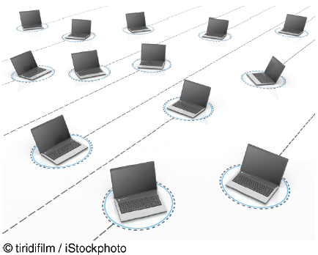
Tapad Can Track You Across Devices
Is Tapad’s business model ethical? Why or why not?
What is the relationship between Tapad’s business model and your privacy? Provide specific examples to support your answer.

Slide 5
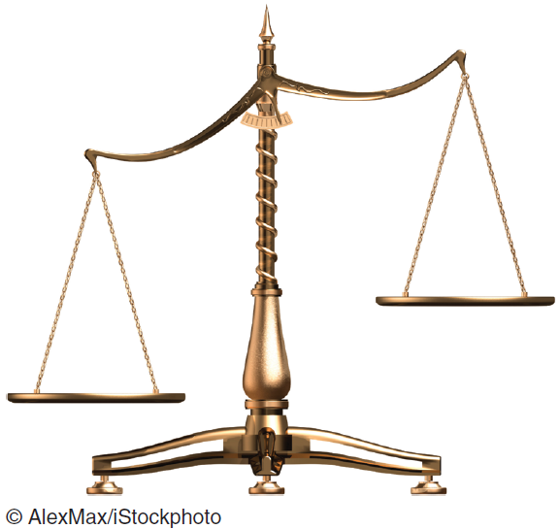
6.1
Ethical Issues
Ethical Frameworks
Ethics in the Corporate Environment
Ethics and Information Technology

Slide 6
Ethics
Ethics refers to the principles of right and wrong that individuals use to make choices that guide their behavior.
Deciding what is right or wrong is not always easy or clear cut. Fortunately, there are many frameworks that can help us make ethical decisions.

Slide 7
Ethical Frameworks
Utilitarian Approach
Rights Approach
Fairness Approach
Common Good Approach
Five Steps of the General Ethical Framework
Notes:
Utilitarian Approach: states that an ethical action is the one that provides the most good or does the least harm.
Rights Approach: maintains that an ethical action is the one that best protects and respects the moral rights of the affected parties.
Fairness Approach: posits that ethical actions treat all human beings equally, or, if unequally, then fairly, based on some defensible standard.
Common Good Approach: highlights the interlocking relationships that underlie all societies. This approach argues that respect and compassion for all others is the basis for ethical actions.

Slide 8
Ethical Frameworks
The utilitarian approach states that an ethical action is the one that provides the most good or does the least harm.
The ethical corporate action would be the one that produces the greatest good and does the least harm for all affected parties—customers, employees, shareholders,
the community, and the environment

Slide 9
Ethical Frameworks
The rights approach maintains that an ethical action is the one that best protects and respects the moral rights of the affected parties.
Moral rights can include the rights to make one’s own choices about what kind of life to lead, to be told the truth, not to be injured, and to a degree of privacy
An ethical organizational action would be one that protects and respects the moral rights of customers, employees, shareholders, business partners, and even competitors.

Slide 10
Ethical Frameworks
The fairness approach posits that ethical actions treat all human beings equally, or, if unequally, then fairly, based on some defensible standard.
For example, most people might believe it is fair to pay people higher salaries if they work harder or if they contribute a greater amount to the firm.
However, there is less certainty regarding CEO salaries that are hundreds or thousands of times larger than those of other employees.
Many people question whether this huge disparity is based on a defensible standard or whether it is the result of an imbalance of power and hence is unfair

Slide 11
Ethical Frameworks
The common good approach highlights the interlocking relationships that underlie all societies.
This approach argues that respect and compassion for all others is the basis for ethical actions.
It emphasizes the common conditions that are important to the welfare of everyone.
These conditions can include a system of laws, effective police and fire departments,healthcare, a public educational system, and even public recreation areas.

Slide 12
Five Steps of the General Ethical Framework
Recognize the Issue
Get the Facts
Evaluate Alternative Actions
Make a Decision and Test It
Act and Reflect on the Outcome of Your Decision
Notes:
Recognize an ethical issue:
• Could this decision or situation damage someone or some group?
• Does this decision involve a choice between a good and a bad alternative?
• Does this issue involve more than simply legal considerations? If so, then in what way?
Get the facts:
• What are the relevant facts of the situation?
• Do I have suffi cient information to make a decision?
• Which individuals and/or groups have an important stake in the outcome?
• Have I consulted all relevant persons and groups?
Evaluate alternative actions:
• Which option will produce the most good and do the least harm? (the utilitarian approach)
• Which option best respects the rights of all stakeholders? (the rights approach)
• Which option treats people equally or proportionately? (the fairness approach)
• Which option best serves the community as a whole, and not just some members? (the common good approach)
Make a decision and test it:
• Considering all the approaches, which option best addresses the situation?
Act and reflect on the outcome of your decision:
• How can I implement my decision with the greatest care and attention to the concerns of all stakeholders?
• How did my decision turn out, and what did I learn from this specifi c situation?

Slide 13
Recognize the Issue
Could this decision or situation damage someone or some group?
Does this decision involve a choice between a good and a bad alternative?
Does this issue involve more than legal considerations? If so, in what way?

Slide 14
Get the Facts
What are the relevant facts of the situation?
Do I have sufficient information to make a decision?
Which individuals and/or groups have an important stake in the outcome?
Have I consulted all relevant persons and groups?

Slide 15
Evaluate alternative actions
Which option will produce the most good and do the least harm? (the utilitarian approach)
Which option best respects the rights of all stakeholders? (the rights approach)
Which option treats people equally or proportionately? (the fairness approach)
Which option best serves the community as a whole, and not just some members? (the
common good approach)

Slide 16
Make a decision and test it
Considering all the approaches, which option best addresses the situation?

Slide 17
Act and reflect on the outcome of your decision
How can I implement my decision with the greatest care and attention to the concerns of all stakeholders?
How did my decision turn out, and what did I learn from this specific situation?

Slide 18
Ethics in the Corporate Environment
Fundamental Tenets of Ethics
Responsibility:means that you accept the consequences of your decisions and actions
Accountability:refers to determining who is responsible for actions that were taken.
Liability:a legal concept that gives individuals the right to recover the damages done to them by other individuals, organizations, or systems.
Notes:
Fundamental Tenets of Ethics:
Responsibility: means that you accept the consequences of your decisions and actions.
Accountability: refers to determining who is responsible for actions that were taken.
Liability: a legal concept that gives individuals the right to recover the damages done to them by other individuals, organizations, or systems.

Slide 19

’S ABOUT BUSINESS 6.1
Cheating Is Risky for Business Students
As the Turnitin database expands rapidly by incorporating a growing number of papers and essays, what will be the impact on subsequent papers submitted to it?
Discuss the ethical implications of writing a paper yourself that you know contains some plagiarized material and then using Turnitin’s service yourself.

Slide 20
Ethics and Information Technology
Consider the following decisions that you might have to make:
Should organizations monitor employees’ Web surfing and e-mail?
Should organizations sell customer information to other companies?
Should organizations audit employ
These issues fall into four general categories: privacy, accuracy, property, and accessibility.
Privacy Issues : involve collecting, storing, and disseminating information about individuals.
Accuracy Issues:involve the authenticity, fidelity, and correctness of information that is collected and processed.
Property Issues:involve the ownership and value of information.
Accessibility Issues:revolve around who should have access to information and whether they should pay a fee for this access.
Notes:
Ethics and Information Technology:
Privacy Issues: involve collecting, storing, and disseminating information about individuals.
Accuracy Issues: involve the authenticity, fidelity, and correctness of information that is collected and processed.
Property Issues: involve the ownership and value of information.
Accessibility Issues: revolve around who should have access to information and whether they should pay a fee for this access.

Slide 21
Privacy Issues
What information about oneself should an individual be required to reveal to others?
What kind of surveillance can an employer use on its employees?
What types of personal information can people keep to themselves and not be forced to reveal to others?
What information about individuals should be kept in databases, and how secure is the information there?

Slide 22
Accuracy Issues
Who is responsible for the authenticity, fidelity, and accuracy of the information collected?
How can we ensure that the information will be processed properly and presented accurately to users?
How can we ensure that errors in databases, data transmissions, and data processing are accidental and not intentional?
Who is to be held accountable for errors in information, and how should the injured parties be compensated?

Slide 23
Property Issues
Who owns the information?
What are the just and fair prices for its exchange?
How should we handle software piracy (copying copyrighted software)?
Under what circumstances can one use proprietary databases?
Can corporate computers be used for private purposes?
How should experts who contribute their knowledge to create expert systems be
compensated?
How should access to information channels be allocated?

Slide 24
Accessibility Issues
Who is allowed to access information?
How much should companies charge for permitting access to information?
How can access to computers be provided for employees with disabilities?
Who will be provided with equipment needed for accessing information?
What information does a person or an organization have a right to obtain, under what conditions, and with what safeguards?

Slide 25
Privacy: Two Rules
Information privacy is the right to determine when, and to what extent, information about you can be gathered and/or communicated to others.
Privacy rights apply to individuals,groups, and institutions.
Court decisions in many countries have generally followed two rules
The right to privacy is not absolute
The public’s right to know supersedes the individual’s right to privacy.

Slide 26
6.2
Privacy
Electronic Surveillance
Personal Information in Databases
Information on Internet Bulletin Boards, Newsgroups, and Social Networking Sites
Privacy Codes and Policies
International Aspects of Privacy
Notes:
Privacy: the right to be left alone and to be free of unreasonable personal intrusions.
Information Privacy: the right to determine when, and to what extent, information about you can be gathered and/or communicated to others.

Slide 27
Electronic Surveillance
Electronic surveillance is rapidly increasing with the emergence of new technologies
Emerging Technologies increase monitoring of human activity
Surveillance cameras track you at airports, subways, banks, and other public venues.
Inexpensive digital sensors are now incorporated into laptop webcams, video-game motion sensors, smartphone cameras, utility meters, passports, employee ID cards
high-resolution photographs taken from the air or from the street by Google or Microsoft
your license plates will be recorded and time-stamped as you drive down a city street, cross a toll bridge, or park at a shopping mall.
Google and Facebook are using facial-recognition software—Google Picasa and Facebook
Photo Albums—in their popular online photo-editing and sharing services. Both companies encourage users to assign names to people in photos, a practice referred to as photo tagging
The law supports the right of employers to read their employees’ e-mail and other electronic documents and to monitor their employees’ Internet use.
organizations routinely monitor their employees’ Internet usage. In addition, two-thirds use software to block connections to inappropriate Web sites, a practice called URL filtering. Further, organizations are installing monitoring and filtering software to enhance security by blocking malicious software and to increase productivity by discouraging employees from wasting time
Notes:
Electronic Surveillance: conducted by employers, the government, and other institutions. Surveillance cameras track you at airports, subways, banks, and other public venues. Inexpensive digital sensors are now incorporated into laptop webcams, video-game motion sensors, smartphone cameras, utility meters, passports, employee ID cards high-resolution photographs taken from the air or from the street by Google or Microsoft , your license plates will be recorded and time-stamped as you drive down a city street, cross a toll bridge, or park at a shopping mall.

Slide 28
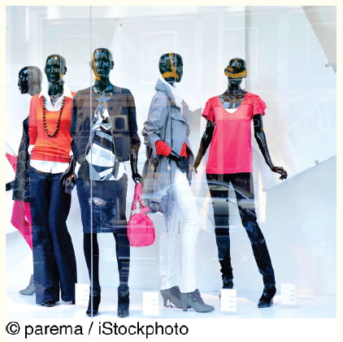
’S ABOUT BUSINESS 6.2
Those Mannequins Are Watching You
Is using EyeSee mannequins in stores an ethical practice? Why or why not? Support your answer.
If stores notify people that they may be filmed, do the stores have to indicate how they might be filmed (i.e., by mannequins)? What are the ethical implications of how stores make these notifications?
Would knowing that the mannequins may be watching you change your shopping behavior? Why or why not? Explain your answer.
What are the privacy implications of the EyeSee mannequins, given that stores already have security cameras placed in strategic locations?

Slide 29
Personal Information in Databases
Modern institutions store information about individuals in many databases. Perhaps the most visible locations of such records are credit-reporting agencies,banks and financial institutions; cable TV, telephone, and utilities companies; employers; mortgage companies; hospitals; schools and universities; retail establishments;government agencies Major Concerns:
Do you know where the records are?
Are the records accurate?
Can you change inaccurate data?
How long will it take to make a change?
Under what circumstances will the personal data be released?

Slide 30
Personal Information in Databases (continued)
Major Concerns:
How are the data used?
To whom are the data given or sold?
How secure are the data against access by unauthorized people?

Slide 31
Information on Internet Bulletin Boards, Newsgroups, and Social Networking Sites
Every day we see more and more electronic bulletin boards, newsgroups, electronic discussions such as chat rooms, and social networking sites. These sites appear on the Internet, within corporate intranets, and on blogs.
Blog (Web Log): an informal, personal journal that is frequently updated and is intended for general public reading.
Conflict between free speech and privacy than the Internet. Many Web sites contain anonymous, derogatory information on individuals, who typically have little recourse in the matter.
Weblog
Free Speech versus Privacy
Notes:
Every day we see more and more electronic bulletin boards, newsgroups, electronic discussions such as chat rooms, and social networking sites. These sites appear on the Internet, within corporate intranets, and on blogs.
Blog (Web Log): an informal, personal journal that is frequently updated and is intended for general public reading.
Conflict between free speech and privacy than the Internet. Many Web sites contain anonymous, derogatory information on individuals, who typically have little recourse in the matter. The vast majority of the U.S. firms use the Internet in examining job applications, including searching on Google and on social networking sites (see closing case 1 in Chapter 8).

Slide 32
’S ABOUT BUSINESS 6.3
Google Glass: Big Brother Really Is Watching You
Apply the general framework for ethical decision making to Google Glass.
Do you feel that the functionality offered by Google Glass outweighs the potential loss of privacy that the technology could create? Why or why not? Support your answer.
Would you use Google Glasses? Why or why not? Support your answer.
If you were at a party or at a bar, would you be comfortable speaking to someone who was wearing Google Glasses? Would you be comfortable just being in the room with someone wearing Google Glasses? Why or why not? Support your answer.

Slide 33
Privacy Codes and Policies
Privacy Policies (or Privacy Codes): an organization’s guidelines for protecting the privacy of its customers, clients, and employees.
Opt-Out Model of Informed Consent: permits the company to collect personal information until the customer specifically requests that the data not be collected.
Opt-In Model of Informed Consent: Privacy advocates prefer this model, which prohibits an organization from collecting any personal information unless the customer specifically authorizes it.
Platform for Privacy Preferences (P3P): a protocol that automatically communicates privacy policies between an electronic commerce Web site and visitors to that site. P3P enables visitors to determine the types of personal data that can be extracted by the sites they visit.
Notes:
Privacy Policies (or Privacy Codes): an organization’s guidelines for protecting the privacy of its customers, clients, and employees.
Opt-Out Model of Informed Consent: permits the company to collect personal information until the customer specifically requests that the data not be collected.
Opt-In Model of Informed Consent: Privacy advocates prefer this model, which prohibits an organization from collecting any personal information unless the customer specifically authorizes it.
Platform for Privacy Preferences (P3P): a protocol that automatically communicates privacy policies between an electronic commerce Web site and visitors to that site. P3P enables visitors to determine the types of personal data that can be extracted by the sites they visit.

Slide 34
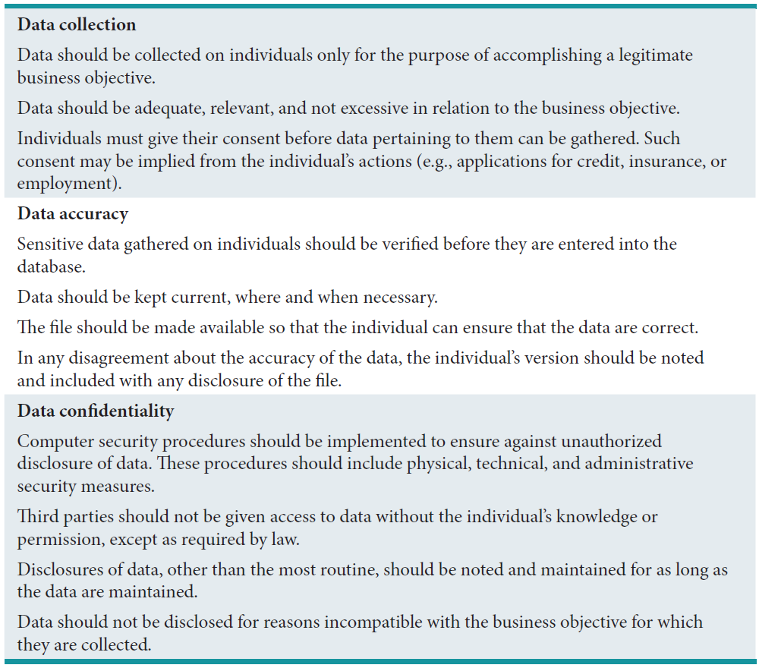
Table 6.2: Privacy Policy Guidelines: A Sampler

Slide 35
International Aspects of Privacy
Inconsistent Privacy and Security Laws
Transborder data flow
European Community Commission
Safe Harbor framework for European citizen personal data
Notes:
Safe Harbor: The U.S. Department of Commerce, in consultation with the European Union, developed a “safe harbor” framework to regulate the way that the U.S. companies export and handle the personal data (e.g., names and addresses) of European citizens.
The European Community Commission (ECC) (1998): issued guidelines to all of its member countries regarding the rights of individuals to access information about themselves. The EU data protection laws are stricter than the U.S. laws and therefore could create problems for the U.S.-based multinational corporations, which could face lawsuits for privacy violations.

